Slide 1
Heat Transfer
CH21004

Slide 2
Boundary and Initial Conditions

Slide 6
One-Dimensional, Steady-State Conduction

Slide 9
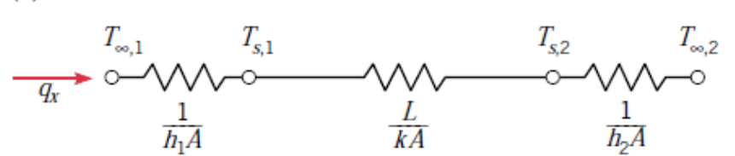
Thermal Resistance
resistance as the ratio of a driving potential to the corresponding transfer rate

Slide 11
The Composite Wall

Slide 14
Contact Resistance

Slide 16
Conduction with Thermal Energy Generation

Slide 17
when both surfaces are maintained at a common temperature

Slide 20
Assumptions
Steady-state conditions
One-dimensional conduction in x-direction
Negligible contact resistance between walls
Inner surface of A adiabatic
Constant properties for materials A and B

